Slide 1




27 January 2026
EcoSure Website Monthly Report Analysis

Slide 2


27 January 2026
This report aims to analyze the website's performance for January 2026, focusing on traffic, user flow, traffic sources, demographics, behaviors, and security.
What Is The Purpose Of This Report?
Key metrics
Traffic overview
Audience demographics
Behavior analysis
Acquisition channels
Conversion tracking
Areas Of Focus:

Slide 3

27 January 2026
Summary
Performance of the website based on data insights
In the past month, the EcoSure website attracted a total of 11K active users, with 10K being new and 1,1K returning users, these are people that accessed the website frequently. The majority of users accessed the site through Paid Search (5,8K users), while smaller numbers came via organic search (1,7K). Zimbabwe contributed the highest traffic, with 9K users. On average, users engaged with the site for 37s seconds per session.

Slide 4
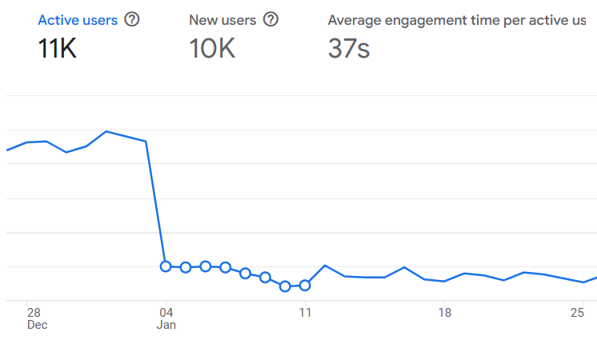
27 January 2026
Site Overview
Emphasizing the important numerical data, the large line chart on the right displays the key metrics for the EcoSure website from the previous month.
It shows:
Users : 11K total users visited the site.
New Users : 10K new users, indicating most visitors were first-time visitors.
Average Engagement Time : Users spent an average of 37s seconds on the site.

Slide 5
27 January 2026
9K
Demographic Overview
Most of the traffic is coming from Zimbabwe(9K users) , followed by China with (379 users) then United States with (356 users) and South Africa with (246 users) each.
379
356
246

Slide 6
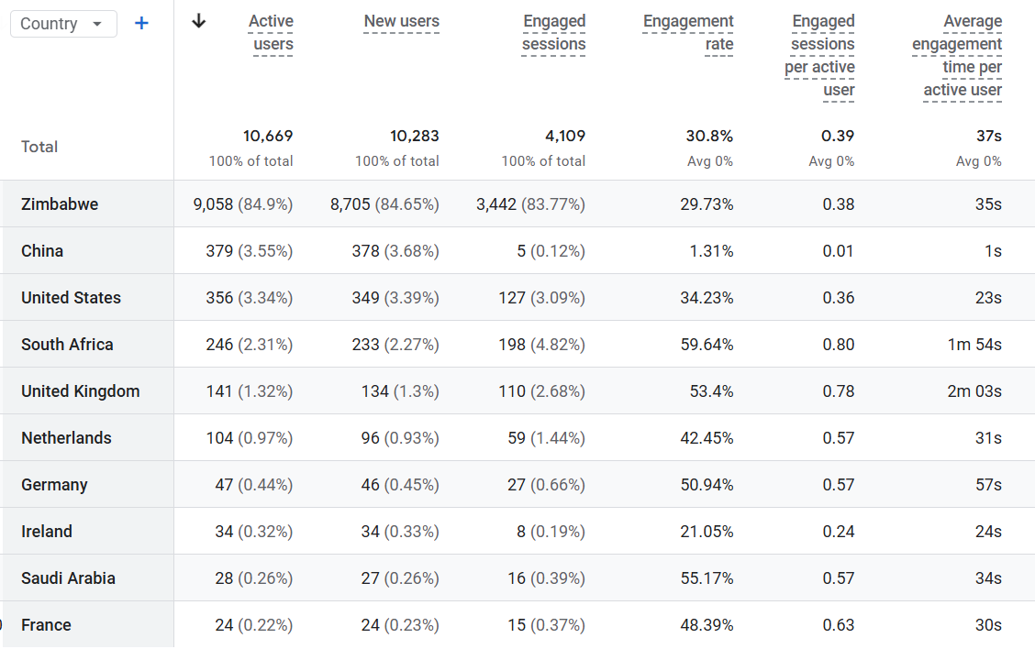
27 January 2026
Demographic Overview

Slide 7
01 July 2025
User Acquisition
The data on this slide illustrates the various traffic channels bringing users to the EcoSure website. The pie chart reveals that the majority of traffic comes from Paid Search.
Source | Users43
Organic Search | 1,695
Paid Search | 5,842

Slide 8
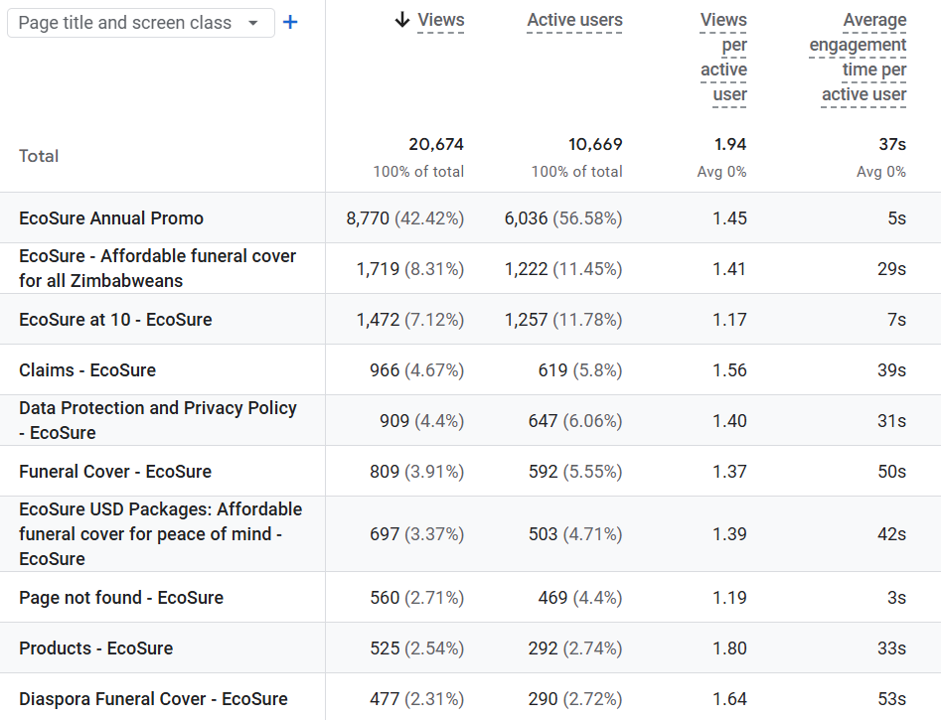

27 January 2026
Pages Sessions
The table shows the top pages visited by users in the previous month

Slide 9
27 January 2026
Behavior Analysis
1,1K
6,1K
8,8K
1,7K
10K
1,5K
966
1,9K
898
879
Users
Engagement Rate Per Week
Page Views
Based on user interactions.
Measure user interaction.
Track page visits.

Slide 10

27 January 2026
Recommendations
Based on data insights
1. Active Users: Increase active users by increasing ads about the Valentines season
2. Comparison tool: Create a tool that users can use to compare different packages side by side.
3. User Engagement: Increase user engagement by highlighting the best packages to buy for the month of February.

